Slide 2
Bird Shaman
Cape Dorset
Bird Shaman
Toonoo Sharky
gk }nr

Slide 3

Bird Shaman
Toonoo Sharky, b. 1970
gk }nr
1995, Stone Cape Dorset, Cape Dorset Gift of Dr. Harry Winrob, 2006-516

Slide 4



Bird Shaman
Exhibition
Toonoo Sharky, b. 1970
Community
gk }nr
REMOVED
1995, Stone Cape Dorset, Cape Dorset Gift of Dr. Harry Winrob, 2006-516

Slide 5
Bird Shaman
Exhibition
Toonoo Sharky, b. 1970
gk }nr
1995, Stone Cape Dorset, Cape Dorset Gift of Dr. Harry Winrob, 2006-516

Slide 6






Bird Shaman
Toonoo Sharky, b. 1970
gk }nr
1995, Stone Cape Dorset, Cape Dorset Gift of Dr. Harry Winrob, 2006-516

Slide 7
Bird Shaman
Toonoo Sharky, b. 1970
gk }nr
Shamanism among Eskimo peoples refers to those aspects of the Eskimo cultures that are related to the shamans’ role as a mediator between people and spirits, souls, and mythological beings. Such beliefs and practices were once widespread among Eskimo groups, but today are rarely practiced.
1995, Stone Cape Dorset, Cape Dorset Gift of Dr. Harry Winrob, 2006-516

Slide 8

Bird Shaman
Toonoo Sharky, b. 1970
gk }nr
Shamanism among Eskimo peoples refers to those aspects of the Eskimo cultures that are related to the shamans’ role as a mediator between people and spirits, souls, and mythological beings. Such beliefs and practices were once widespread among Eskimo groups, but today are rarely practiced.
Shamanism among Eskimo peoples refers to those aspects of the Eskimo cultures that are related to the shamans’ role as a mediator between people and spirits, souls, and mythological beings. Such beliefs and practices were once widespread among Eskimo groups, but today are rarely practiced.
1995, Stone Cape Dorset, Cape Dorset Gift of Dr. Harry Winrob, 2006-516

Slide 9

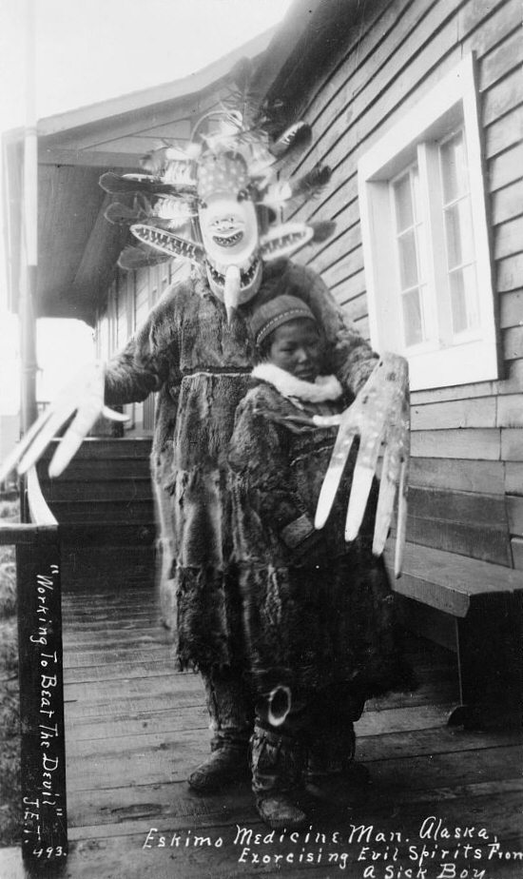
Bird Shaman
Toonoo Sharky, b. 1970
gk }nr
Shamanism among Eskimo peoples refers to those aspects of the Eskimo cultures that are related to the shamans’ role as a mediator between people and spirits, souls, and mythological beings. Such beliefs and practices were once widespread among Eskimo groups, but today are rarely practiced.
Shamanism among Eskimo peoples refers to those aspects of the Eskimo cultures that are related to the shamans’ role as a mediator between people and spirits, souls, and mythological beings. Such beliefs and practices were once widespread among Eskimo groups, but today are rarely practiced.
1995, Stone Cape Dorset, Cape Dorset Gift of Dr. Harry Winrob, 2006-516

Slide 10
Bird Shaman
Toonoo Sharky, b. 1970
gk }nr
1995, Stone Cape Dorset, Cape Dorset Gift of Dr. Harry Winrob, 2006-516

Slide 11
Bird Shaman
Exhibition
Toonoo Sharky, b. 1970
gk }nr
1995, Stone Cape Dorset, Cape Dorset Gift of Dr. Harry Winrob, 2006-516

Slide 12
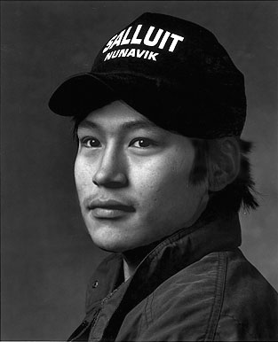
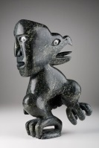
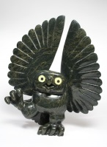
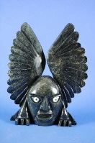
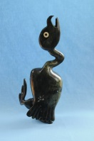
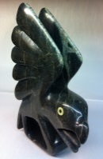
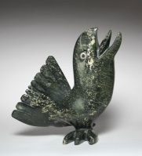
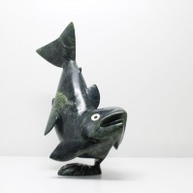
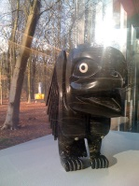
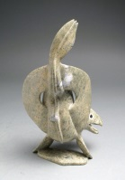
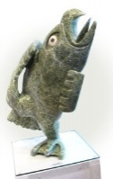
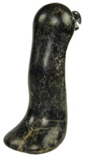
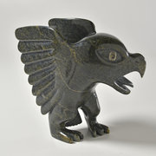
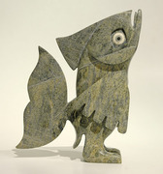
Toonoo Sharky began carving at age nine, taught by his grandfather. His favourite subjects are “birds, and anything with wings.” But asked if he observed birds in nature, he replies: “Not often. You can look at them or work from your imagination. I don’t observe them; it is all from my head.” Toonoo’s visual statement is more emblematic than truly representative of the transformation process. For younger generations of Inuit, the imagining of shamanism and its various attributes has to a large extent supplanted actual knowledge of and belief in it.
Bird Shaman
Toonoo Sharky, b. 1970
gk }nr
1995, Stone Cape Dorset, Cape Dorset Gift of Dr. Harry Winrob, 2006-516

Slide 13

Toonoo Sharky, 1970
Cape Dorset, CA
Bird Shaman
Toonoo Sharky began carving at age nine, taught by his grandfather. His favourite subjects are “birds, and anything with wings.” But asked if he observed birds in nature, he replies: “Not often. You can look at them or work from your imagination. I don’t observe them; it is all from my head.” Toonoo’s visual statement is more emblematic than truly representative of the transformation process. For younger generations of Inuit, the imagining of shamanism and its various attributes has to a large extent supplanted actual knowledge of and belief in it.
Toonoo Sharky, b. 1970
gk }nr
1995, Stone Cape Dorset, Cape Dorset Gift of Dr. Harry Winrob, 2006-516

Slide 14
Bird Shaman
Exhibition
Toonoo Sharky, b. 1970
gk }nr
1995, Stone Cape Dorset, Cape Dorset Gift of Dr. Harry Winrob, 2006-516

Slide 15


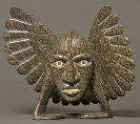





Bird Shaman
Shaman
Bird Spirits
Toonoo Sharky, b. 1970
gk }nr
Barnabus A.
Toonoo Sharky
Shaman
Steatite
Birds
Stone
Bird Shaman
Musk Ox
Toonoo Sharky
Barnabus A.
Birds
Stone
Ox
Stone
Amauti Dress
Preparing to Fly
Talerook, M.
Toonoo Sharky
Amauti
Fabric
Birds
Stone
Musk Ox
Arviat
1995, Stone Cape Dorset, Cape Dorset Gift of Dr. Harry Winrob, 2006-516
Lucassie I.
Anowtalik, L.
Ox
Antler
Antler

Slide 16
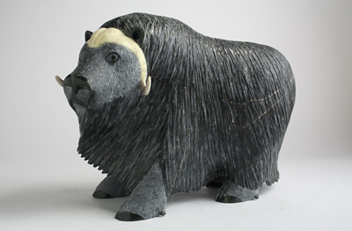
Bird Shaman
Shaman
Bird Spirits
Toonoo Sharky, b. 1970
gk }nr
Barnabus A.
Toonoo Sharky
Shaman
Steatite
Birds
Stone
Bird Shaman
Musk Ox
Toonoo Sharky
Barnabus A.
Birds
Stone
Ox
Stone
Amauti Dress
Preparing to Fly
Talerook, M.
Toonoo Sharky
Amauti
Fabric
Birds
Stone
Musk Ox
Arviat
1995, Stone Cape Dorset, Cape Dorset Gift of Dr. Harry Winrob, 2006-516
Lucassie I.
Anowtalik, L.
Ox
Antler
Antler

Slide 17
Bird Shaman
Shaman
Bird Spirits
Toonoo Sharky, b. 1970
gk }nr
Barnabus A.
Toonoo Sharky
Shaman
Steatite
Birds
Stone
Bird Shaman
Musk Ox
Toonoo Sharky
Barnabus A.
Birds
Stone
Ox
Stone
Amauti Dress
Preparing to Fly
Talerook, M.
Toonoo Sharky
Amauti
Fabric
Birds
Stone
Musk Ox
Arviat
1995, Stone Cape Dorset, Cape Dorset Gift of Dr. Harry Winrob, 2006-516
Lucassie I.
Anowtalik, L.
Ox
Antler
Antler

Slide 18
Bird Shaman
Shaman
Bird Spirits
Toonoo Sharky, b. 1970
gk }nr
Barnabus A.
Toonoo Sharky
Shaman
Steatite
Birds
Stone
Bird Shaman
Musk Ox
Toonoo Sharky
Barnabus A.
Birds
Stone
Ox
Stone
Amauti Dress
Preparing to Fly
Talerook, M.
Toonoo Sharky
Amauti
Fabric
Birds
Stone
Musk Ox
Arviat
1995, Stone Cape Dorset, Cape Dorset Gift of Dr. Harry Winrob, 2006-516
Lucassie I.
Anowtalik, L.
Ox
Antler
Antler

Slide 19
Bird Shaman
Exhibition
Toonoo Sharky, b. 1970
gk }nr
1995, Stone Cape Dorset, Cape Dorset Gift of Dr. Harry Winrob, 2006-516

Slide 20
Bird Shaman
Toonoo Sharky, b. 1970
gk }nr
1995, Stone Cape Dorset, Cape Dorset Gift of Dr. Harry Winrob, 2006-516

